Slide 1
Virtual Whiteboard
Calvin Hamus
Justin Tolman
Milson Munakami
Patrick Lee

Slide 2

Agenda
Objective
Introduction / Key Concept
Technologies Used
Libraries
API Descriptions
Future Improvements
Demo
Q & A

Slide 3

What is Virtual Whiteboard ?
Online Interactive White Boards
Collaborating Tools
Real-time virtual rooms, Text-chat and more.

Slide 4
Problem
Geographical location and timing
Sharing knowledge
Interactive Teaching
Training and tutoring
Creative brainstorming
Sales and product demos
Interviews and tests

Slide 5
Solution
Web-based online virtual whiteboard
Real-time multi-user collaboration
Text chat with users
Run unlimited sessions

Slide 6
Technologies Used
Dev environment setup using Vagrant and Puppet
MySQL database
Java REST API
NodeJS server and load balancer
Nginx load balancer
Redis
JavaScript client app
SocketIO

Slide 7
Setup
1 load balancer
3 back-end Tomcat servers (Java API)
3 NodeJS servers
1 MySQL database (DB) server
Tomcat servers

Slide 8
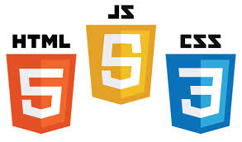


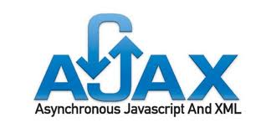
Client Side
Out client side implementation utilizes
some of the latest web technologies.
HTML5, CSS3, and the latest JavaScript methods allow for
much greater flexibility in what can be done within a browser.
With canvas and SVG this includes image manipulation.
The w3c is planning increased future integration of between them.
We use web sockets for real time interaction
and AJAX style calls for database interactions.

Slide 9
Client Side Third Party Resources
jQuery
JavaScript's prototypical inheritance with the convenience of CSS selectors
jQuery-ui
Store state information for useful graphical tools.
normalize.css
Sets up a common starting place so your stylesheets will work the same in all browsers.
Spectrum
A color picker plug-in for jQuery
jQuery.contextMenu
A context based right click menu plug-in for jQuery. (We haven't actually implemented it yet,)

Slide 10
Graphics
Raster vs. Vector

Slide 11

Extensibility & Potential Improvements
We designed our application to be easily extended and added upon. Some additional potential uses are:
Additional drawing tools. The sky's the limit on this one, and with jQuery's plug-in
architecture they can be added without modification to existing code in most cases.
File collaboration. With the addition of a file server we could easily include the ability to share files.
Slide Presentations. It would be fairly easy to save specific drawings as slides, and play them back
3D. WebGL and three.js are compatible with the technologies we're using, with some work
collaboration on 3D projects like architecture, manufacturing, and 3D printing could be integrated.

Slide 12
NodeJs and SocketIO
My Objective
Use a scripting language server (Node) to scale to a cloud based architecture.
Challenge
Scale a system that does not want to scale nicely

Slide 13
Node Architecture
Node LB
Node One
Node Two
SocketIO
SocketIO
Redis

Slide 14
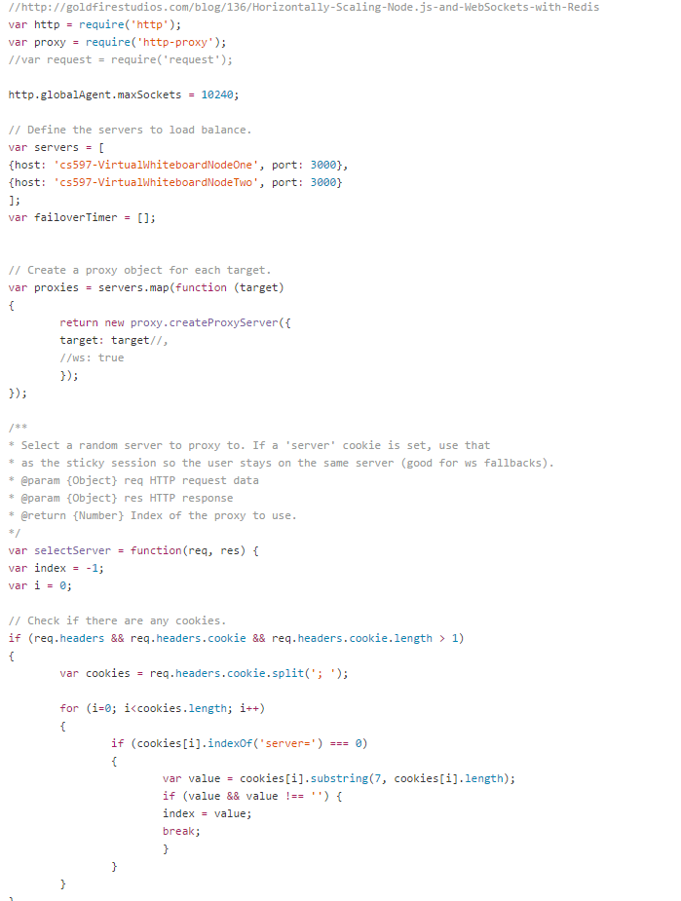
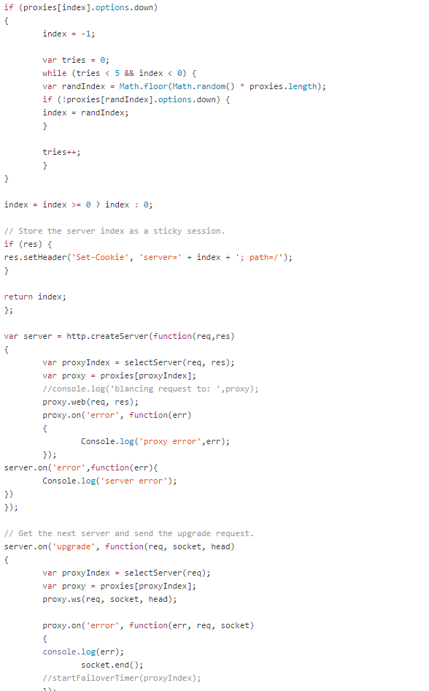
Node LB

Slide 15
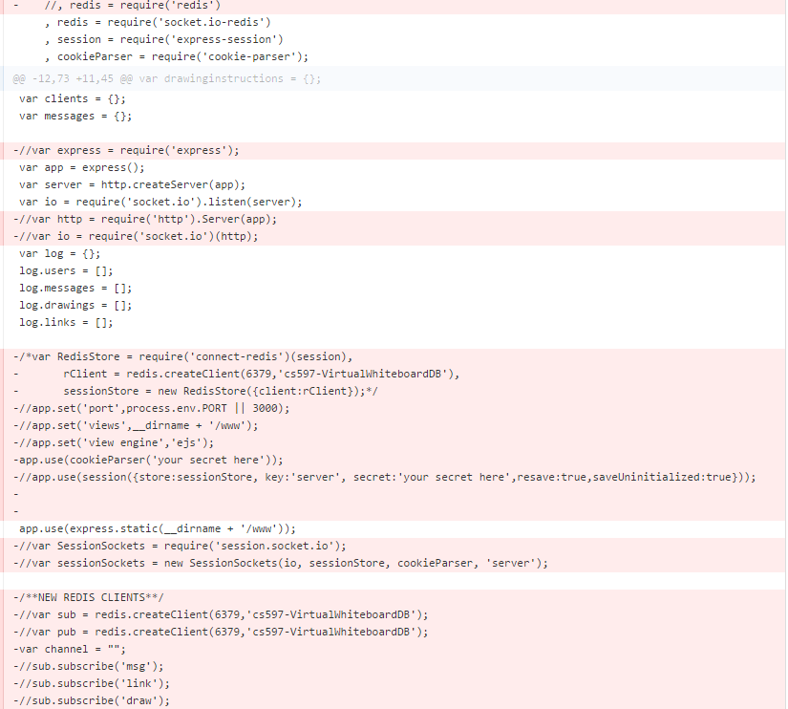

Pre socket-io-redis
Node Issues
Load balance socketIO?
Redis
Post

Slide 16
Node Issues Part 2
SocketIo Rooms?
Solution – keep all changes in data base and populate room when new user joins room.

Slide 17
JAVA API: Requirements
Save whiteboard changes and chat messages in real-time
Send history of rooms to users upon entry
Use flexible data format to support new features
Handle write-heavy workload

Slide 18


Java API: Technologies
Nginx load balancer
MySQL database
Tomcat app server
Maven, Jersey, Jackson, Hibernate, C3P0
Primary challenge...
connection pooling and performance under load

Slide 19
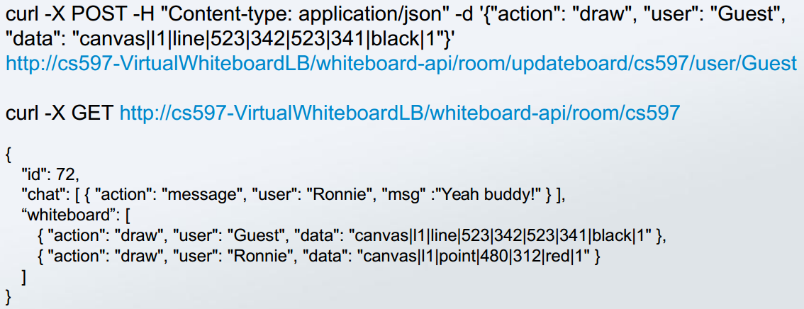
Java API: Examples

Slide 20

Dev Setup: The problem?
Applications can be complex and hard to set up manually
Differences in base OS, software versions, config files...
End up with “snowflake setups” (no two are alike)
The dreaded “Works On My Box”

Slide 21

Dev Setup: The solution?
VAGRANTFILE_API_VERSION = "2"
Vagrant.configure(VAGRANTFILE_API_VERSION) do |config|
config.vm.box = "ubuntu/trusty64"
dev.vm.provider "virtualbox" do |vb|
vb.memory = 1024
vb.cpus = 2
end
dev.vm.provision "puppet" do |puppet|
puppet.manifests_path = "puppet/manifests"
puppet.manifest_file = "site.pp"
puppet.module_path = "puppet/modules"
end
end

Slide 22

Dev Setup: The solution?
class nginx {
package { 'nginx': ensure => present }
service { 'nginx':
ensure => running,
require => Package['nginx'];
}
file { '/etc/nginx/nginx.conf':
source => 'puppet:///modules/nginx/nginx.conf',
require => Package['nginx'],
notify => Service['nginx'];
}
}

Slide 23
Dev Setup: The nickel tour
Let's have a quick look before the real demo

Slide 24

Demo

Slide 25

Q&A

Slide 26
Thank you!

